Slide 2
Antra SEP Program
SQL Server and Databases
Day 3

Slide 3
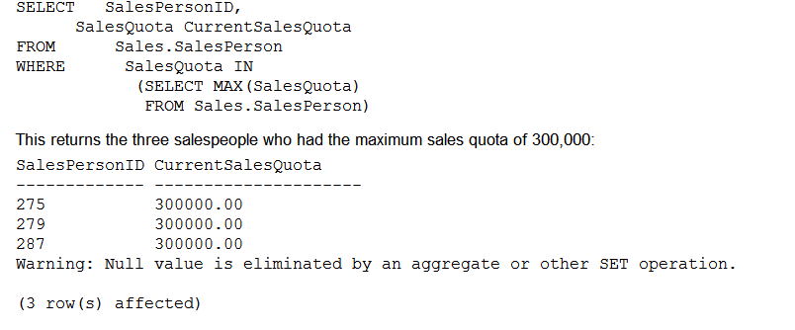
Sub Queries
A subquery is a SELECT query that is nested within another SELECT, INSERT, UPDATE, or DELETE statement. A subquery can also be nested inside another subquery

Slide 4
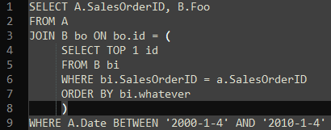
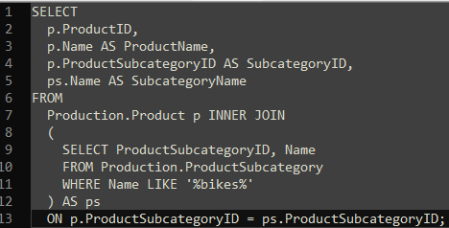
Subquery
Sub query usually involves an operation in the where condition: >, <, EXIST, ALL, IN, =,

Slide 5
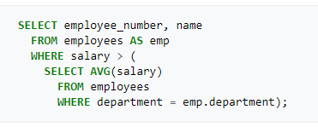
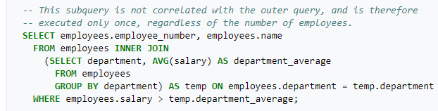
Correlated subquery
In a SQL database query, a correlated subquery (also known as a synchronized subquery) is a subquery (a query nested inside another query) that uses values from the outer query. Because the subquery may be evaluated once for each row processed by the outer query, it can be inefficient.
Same reason to use temp table, cte and tb var if needed.

Slide 6
Union and Union ALL
Union and Union All are all for combining result set together, vertically.
UNION removes duplicate records (where all columns in the results are the same), UNION ALL does not.
There is a performance hit when using UNION vs UNION ALL, since the database server must do additional work to remove the duplicate rows, but usually you do not want the duplicates (especially when developing reports).
When using Union and Union All, you need to make sure the numbers of columns and date type of each column from all result set should be the same.

Slide 7
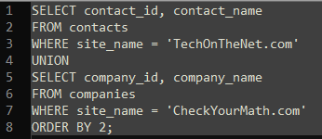
Union

Slide 8
Common Table Expressions
A CTE can be used to:
Create a recursive query.
Substitute for a view when the general use of a view is not required; that is, you do not have to store the definition in metadata.
Using a CTE offers the advantages of improved readability and ease in maintenance of complex queries. The query can be divided into separate, simple, logical building blocks. These simple blocks can then be used to build more complex, interim CTEs until the final result set is generated.
CTEs can be defined in user-defined routines, such as functions, stored procedures, triggers, or views.
Notes:
8

Slide 9
Common Table Expressions Cont
It is applied for
Temporary Views
Enable Recursive Queries
--Ex: List all Sales Persons and their number of orders.
WITH Sales_CTE (SalesPersonID, NumberOfOrders, MaxDate)
AS
(
SELECT SalesPersonID, COUNT(*), MAX(OrderDate)
FROM Sales.SalesOrderHeader
GROUP BY SalesPersonID
)
SELECT * FROM Sales_CTE where MaxDate > ‘2017-01-01’
Notes:
9

Slide 10
Common Table Expressions Cont
Collateral benefit – improve readability and manageability of complex SQL Statements
Similar to VIEWs and even more to Derived Tables
Over time most of the CTEs will be used for this purpose
Now before going further let us take one scenario:
There is a table with employee details. It stores the employee name with corresponding employee ID, manager ID and salary.
Notes:
10

Slide 11
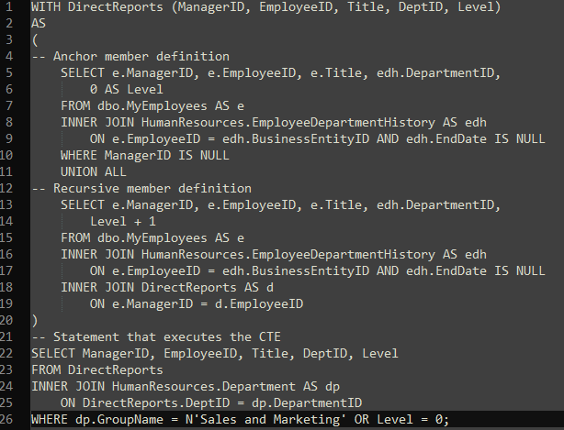
CTE Example

Slide 12
Common Table Expressions Cont
The data in the table is as follows:
 | empid | mgrId | empname | Salary
1 | 1 | NULL | Nancy | 10000.00
2 | 2 | 1 | Andrew | 5000.00
3 | 3 | 1 | Janet | 5000.00
4 | 4 | 1 | Margaret | 2500.00
5 | 5 | 2 | Steven | 2500.00
6 | 6 | 2 | Micheal | 2500.00
7 | 7 | 3 | Robert | 2500.00
8 | 8 | 3 | Laura | 2500.00
9 | 9 | 3 | Ann | 2500.00
10 | 10 | 4 | Ina | 2500.00
11 | 11 | 7 | David | 2000.00
12 | 12 | 7 | Ron | 2000.00
13 | 13 | 7 | Dan | 2000.00
14 | 14 | 11 | James | 1500.00
Now the requirement is to display the employee whose empid is 3 and all the employees and sub employees working under him/her.

Slide 13
Common Table Expressions Cont
The easiest solution to this problem would be a recursive CTE. Recursive form of CTE
<non-recursive SELECT>
UNION ALL
<SELECT referencing CTE>
--Display the employee whose empid is 3 with the employees and sub employees working under him/her
WITH EmpCTE (empid, empname, mgrid)
AS (
SELECT empid, empname, mgrid
FROM Employees WHERE empid = 3
UNION ALL
SELECT E.empid, E.empname, E.mgrid
FROM Employees AS E JOIN EmpCTE AS M ON E.mgrid = M.empid
)
SELECT * FROM EmpCTE

Slide 14
Common Table Expressions Cont
Here is the output
Results Messages
 | empid | empname | mgrid
1 | 3 | Janet | 1
2 | 7 | Robert | 3
3 | 8 | Laura | 3
4 | 9 | Ann | 3
5 | 11 | David | 7
6 | 12 | Ron | 7
7 | 13 | Dan | 7
8 | 14 | James | 1

Slide 15
Temporary Tables
Temporary tables are defined just like regular tables, only they are automatically stored in the tempdb database.
Temporary table types:
Local : Local temporary tables are prefixed with a single # sign
Global: global temporary tables with a double ## sign.
Local temporary tables are available for use by the current user connection that created them. Multiple connections can create the same-named temporary table for local temporary tables without encountering conflicts. The internal representation of the local table is given a unique name, so as not to conflict with other temporary tables with the same name created by other connections in the tempdb database
Global temporary tables have a different scope from local temporary tables. Once a connection creates a global temporary table, any user with proper permissions access to the current database they are in have access to the table. Unlike local temporary tables, you can’t create simultaneous versions of a global temporary table, as this will generate a naming conflict. Global temporary tables are removed from SQL Server if explicitly dropped by DROP TABLE. They are also automatically removed after the connection that created it exits and the global temporary table is no longer referenced by other connections

Slide 16
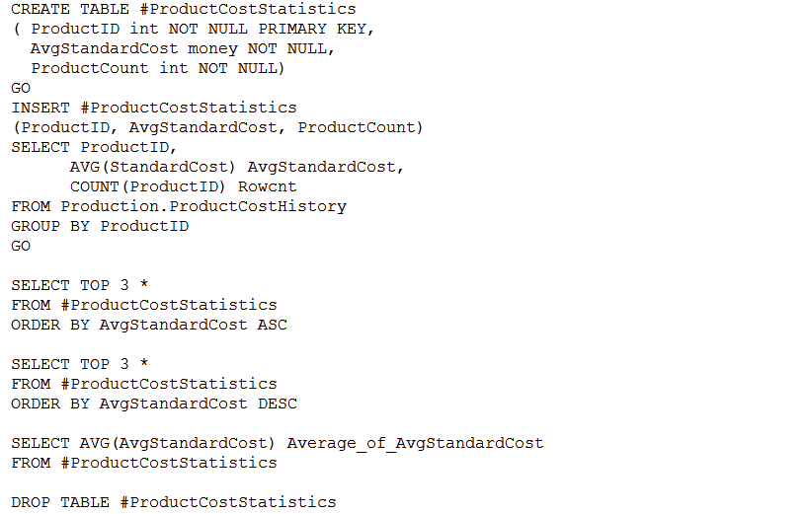
Creating Temp Tabels

Slide 17
Table Variable
Temporary tables causes performance issues
Temporary tables may cause unwanted disk overhead in tempdb, locking of tempdb during their creation, as well as cause stored procedure recompilations, when included within a stored procedure’s definition
Microsoft recommends table variables as a replacement of temporary tables when the data set is not very large
A table variable is a data type that can be used within a Transact-SQL batch, stored procedure, or function—and is created and defined similarly to a table, only with a strictly defined lifetime scope.
Unlike regular tables or temporary tables, table variables can’t have indexes or FOREIGN KEY constraints added to them. Table variables do allow some constraints to be used in the table definition (PRIMARY KEY, UNIQUE, CHECK).

Slide 18
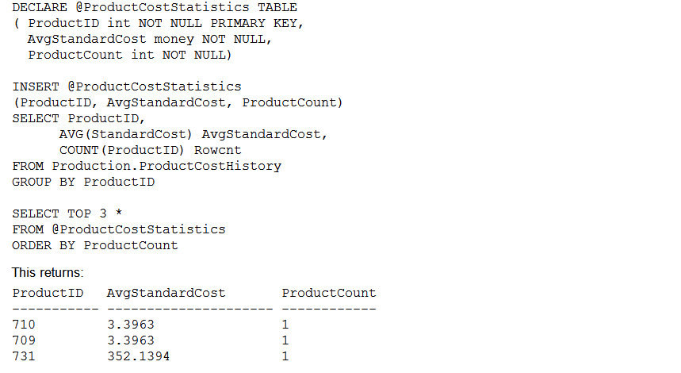
Table Variables
DECLARE @TableName TABLE (column_name <data_type> [ NULL | NOT NULL ] [ ,...n ] )

Slide 19
Benefits
Well scoped. The lifetime of the table variable only lasts for the duration of the batch, function, or stored procedure
Shorter locking periods (because of the tighter scope).
Less recompilation when used in stored procedures
Table variable performance suffers when the result set becomes too large

Slide 20
Rank
Returns the rank of each row within the partition of a result set. The rank of a row is one plus the number of ranks that come before the row in question.
ROW_NUMBER and RANK are similar. ROW_NUMBER numbers all rows sequentially (for example 1, 2, 3, 4, 5). RANK provides the same numeric value for ties (for example 1, 2, 2, 4, 5).
Dense_Rank returns the rank of rows within the partition of a result set, without any gaps in the ranking.

Slide 21
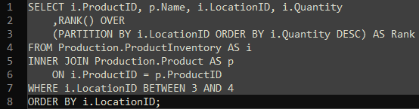
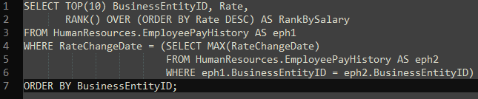
Example: Rank

Slide 22
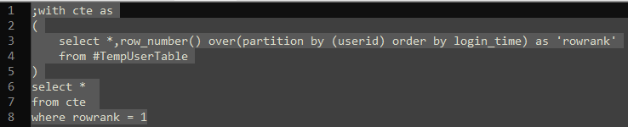
Example: CTE with Rank

Slide 23
Cursor
IT is a object to be applied on a result set to read and load the result row by row, so you can operate on each row.
It will be a performance killer but it is still useful on data migration processes.
Defines the attributes of a Transact-SQL server cursor, such as its scrolling behavior and the query used to build the result set on which the cursor operates. DECLARE CURSOR accepts both a syntax based on the ISO standard and a syntax using a set of Transact-SQL extensions.

Slide 24
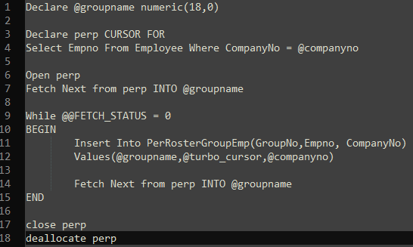
Cursor

Slide 25
Insert
The simplified syntax for the INSERT command
INSERT [ INTO] table_or_view_name [ ( column_list ) ] VALUES ({DEFAULT | NULL | expression } [ ,...n ])
INSERT Production.Location (Name, CostRate, Availability) VALUES ('Wheel Storage', 11.25, 80.00 ) Values(…)

Slide 26
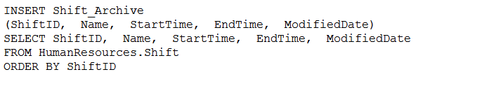
Inserting Rows Using an INSERT...SELECT Statement

Slide 27
Update
Basic syntax for the UPDATE statement
UPDATE <table_or_view_name> SET column_name = {expression | DEFAULT | NULL} [ ,...n ] WHERE <search_condition>
UPDATE Sales.SpecialOffer SET DiscountPct = 0.15 WHERE SpecialOfferID = 10
UPDATE Sales.ShoppingCartItem SET Quantity =2, ModifiedDate = GETDATE() FROM Sales.ShoppingCartItem c INNER JOIN Production.Product p ON c.ProductID = p.ProductID WHERE p.Name = 'Full-Finger Gloves, M ' AND c.Quantity > 2

Slide 28
Delete
Syntax for DELETE
DELETE FROM table_or_view_name WHERE search_condition
DELETE FROM Production.Example_ProductProductPhoto
DELETE FROM Production.Example_ProductProductPhoto WHERE ProductID NOT IN (SELECT ProductID FROM Production.Product)
DELETE Production.ProductProductPhoto FROM Production.Example_ProductProductPhoto ppp LEFT OUTER JOIN Production.Product p ON ppp.ProductID = p.ProductID WHERE p.ProductID IS NULL

Slide 29
Truncating a Table
TRUNCATE TABLE table_name
TRUNCATE TABLE Sales.Example_StoreContact

Slide 30
Differences
Truncate reseeds identity values, whereas delete doesn't.
Truncate removes all records and doesn't fire triggers.
Truncate is faster compared to delete as it makes less use of the transaction log.
Truncate is not possible when a table is referenced by a Foreign Key or tables are used in replication or with indexed views.

